Slide 1
Communication
PDR Slides

Slide 2
Communication – Requirements
Industrial Grade Radio
Withstand the environment
Reliability and high efficiency
Data Storage and Transmission
Store and transfer data packets when link is available
Desired Orbit for Data Transfer
Need unit to fly near data stations for downlink

Slide 3
Communication - Solutions

Slide 4

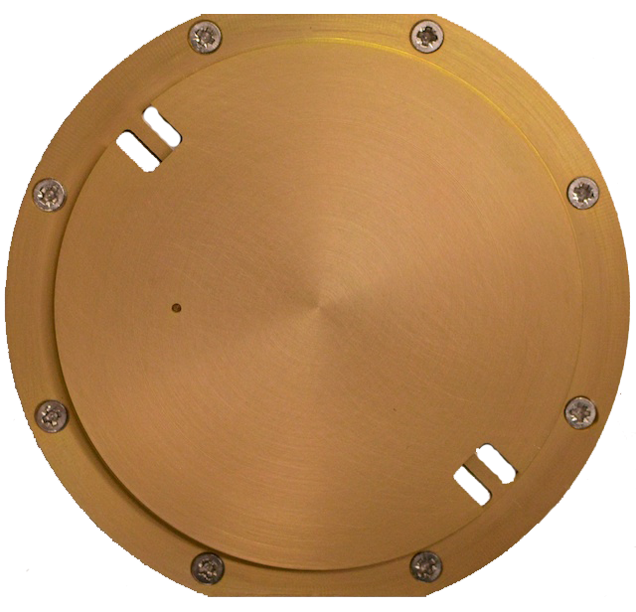
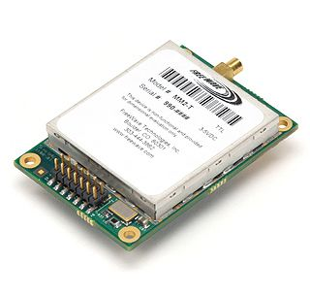


Communication – Scenario 1
Power
-Wattage
-Battery
GPS
-Attitude
-Position
-Time
Gamma Ray Detector
Antenna
Radio
Flight Computer
-Assemble packet
Used if data packets are large and connecting to ground stations is difficult

Slide 5
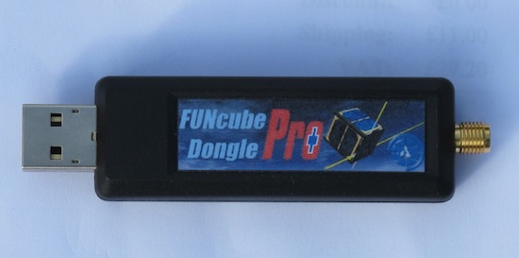
Communication – Scenario 2
Power
-Wattage
-Battery
GPS
-Attitude
-Position
-Time
Gamma Ray Detector
Antenna
FunCube
Flight Computer
-Assemble packet
Cheaper approach if data packets are small enough

